Slide 1
TRUE or FALSE
This is a general knowledge quiz on drugs with notes for the staff.

Slide 2
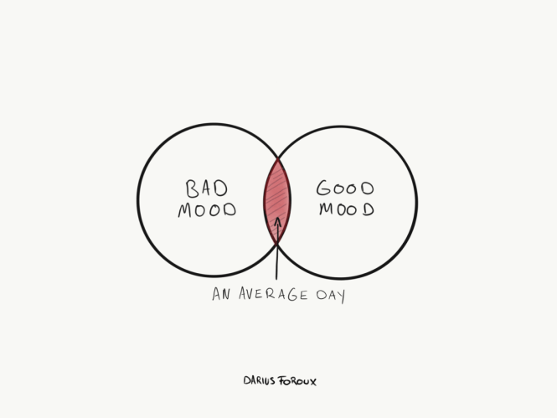
1.
A drug is defined as “…a mood altering substance.”
True False
Notes:
This is true. To expand, a “Drug” has three main definitions.
1) A mood-altering substance.
2) A substance which had a physiological and psychological effect when ingested or introduced into the body.
3) A substance that affects the nervous system.

Slide 3
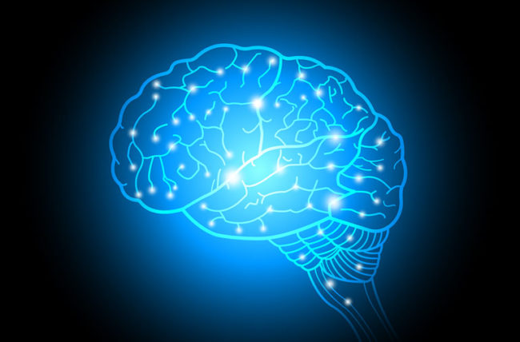
2.
A mental and physical addiction are the same.
True False
Notes:
Simply defined, you have a physical addiction when you repeatedly use a drug until you become so dependent on it that your body can no longer function without it. To become physically addicted, the drugs need to have a company that forces your body to become dependent.
A mental/psychological addiction does not only happen with drugs. It can occur with activities such as gaming, gambling etc.
The symptoms of psychological addiction can be very strong and debilitating. They include:
Intense substance cravings
Appetite loss
Denial
Inability to imagine coping without the substance
Appetite loss

Slide 4

3.
It is safe to drive after smoking cannabis?
True False
Notes:
- Cannabis is a depressant. This means it typically slows your body down. As a result, your reaction time will be affected, making you a hazard on the road. Driving whilst under the influence of illicit drugs is illegal. Remind the YP that driving irresponsibly is putting people’s lives at risk.

Slide 5
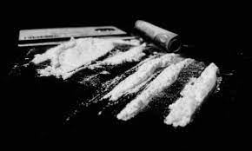
4.
Cocaine is a depressant.
True False
Notes:
Cocaine is a stimulant. A stimulant is a group of drugs that typically increase energy and motivation. They increase the heart rate of a person too. One of the risks of stimulants is that they increase the likelihood of heart attacks particularly whilst under the influence.

Slide 6
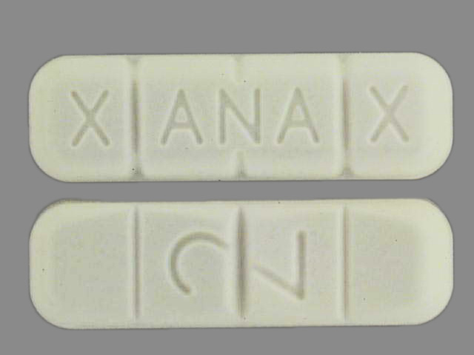
5.
Xanax is a benzodiazepine
True False
Notes:
Xanax is a drug that is typically prescribed in America for anxiety. For some time, it was really popular amongst young people. What to be aware of is that Xanax can become physically addictive and when mixed with alcohol it can become fatal. The advise is to of course not use it but if the YP is, they should use it in isolation and not mix.

Slide 7

6.
Long term alcohol use can damage the liver.
True False
Notes:
This is true. The liver and the kidney are responsible for filtering out the alcohol. An increase in tolerance is a defensive mechanism put in place by your body. However, typically, people see this as a reason to drink MORE. To put it simply over time, these organs become worn out and start to malfunction.

Slide 8
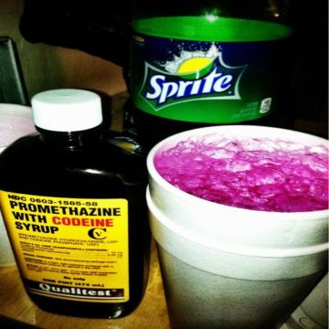
7.
Codeine lean is a physically addictive drug.
True False
Notes:
This is true. Codeine lean is in the opiate family and has physically addictive properties. Long-term use can result in seizures.
This is true. The opium family is a family of different drugs that come from the same plant. codeine is in this family of drugs. Similarly, heroin is also in the family. The main risk of drugs in the family is physical addiction. The longer the use the more addicted the person becomes.

Slide 9
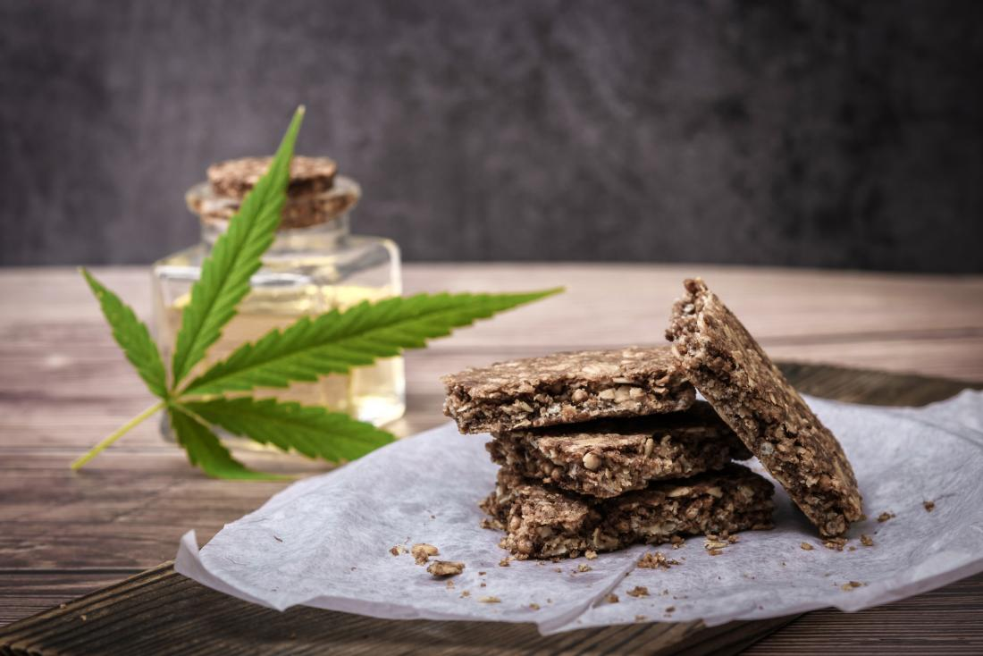
8.
Edibles and weed are different drugs.
True False
Notes:
Edibles have the same chemicals and compounds that cannabis has. Although edibles are made differently as the oils are typically extracted and mixed in with other foods. For example, cake/brownie batter. The way cannabis works and the effects it has on the body are almost identical. The main difference is THE WAY it starts to work. One is being smoked (the high should come relatively quickly.) and the other is ingested (the high takes a little longer to take effect.)

Slide 10
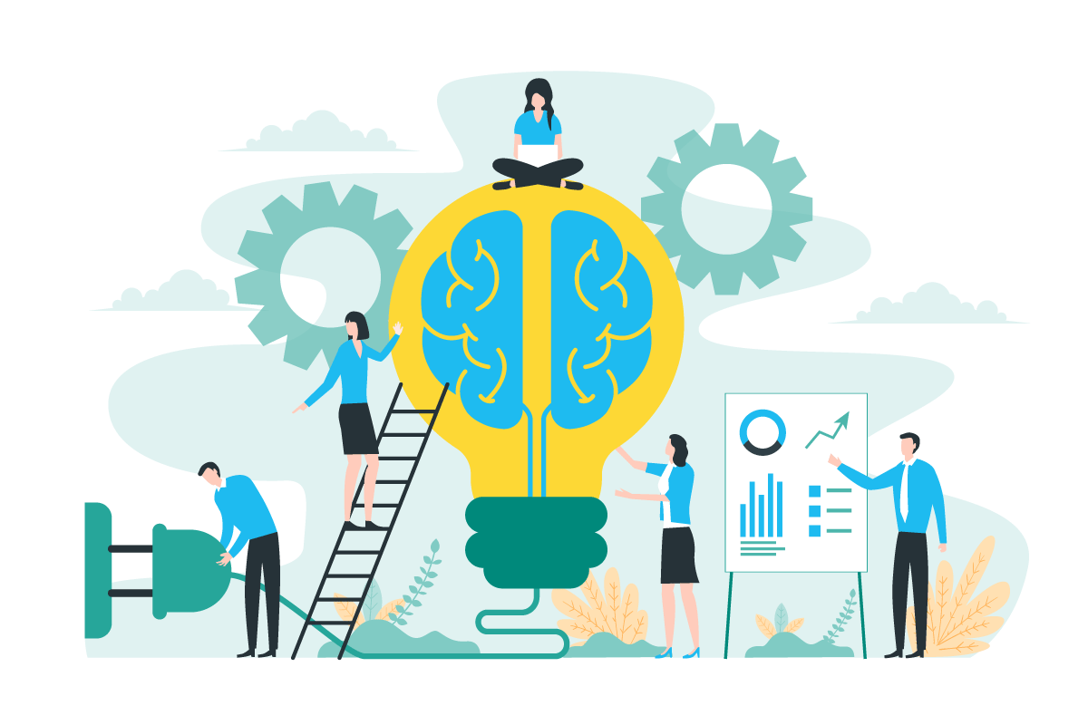
9.
Early use of drugs affects your development.
True False
Notes:
Most drugs if not all directly affect the brain and the central nervous system. The earlier you start using them, the more they “stunt” your growth. Your brain will continue to develop at an optimum till about 25, creating new networks and patterns. This brain development is what helps you remember information, think fast, solve problems etc. interrupting this development essentially limits your intellectual capacity.
Think of your brain as a hard drive, the more drugs you use particularly at a young age, the more spam and virus you store in this hard drive.

Slide 11
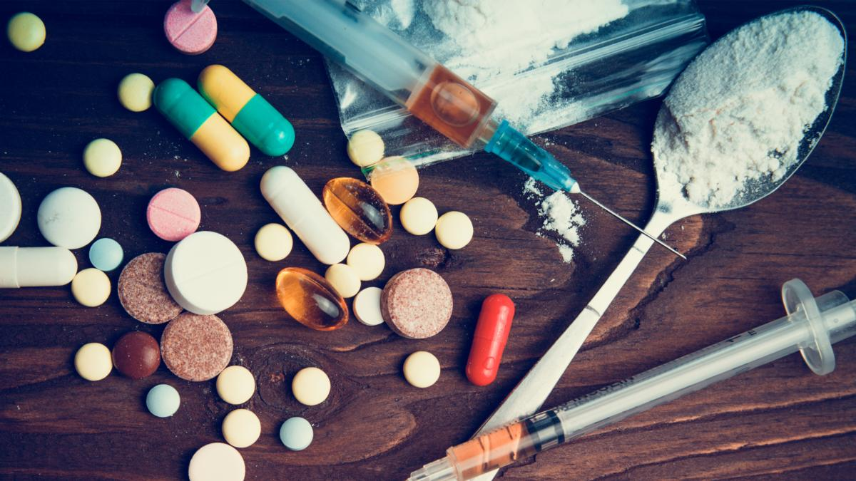
10.
All drugs are bad.
True False
Notes:
This is something to discuss. Legal drugs are not bad. But think about what makes them so and what makes illicit drugs bad. Does the YP agree? Or disagree?

Slide 12
TRUE
FALSE
Cocaine is a stimulant.
Early use of drugs affects your development.
Edibles and weed are different.
Long term alcohol use can damage the liver.
All drugs are bad.
Its safe to drive after smoking cannabis?
A mental and physical addiction are the same.
Its safe to drive after smoking cannabis?
Xanax is in the same family as heroin?
A drug is defined as “…a mood altering substance.”

